Slide 1
Linux File System
CSC 7132
Nguyen Thai
Materials modified by Prof. Nguyen Thai from Advanced Programming in the UNIX Environment
by Steven and Rago, 3rd Edition, Addison-Wesley 2013

Slide 2
File Descriptor
When we open an existing file or create a new file, the kernel returns a file descriptor to the process
Kernel refers to open files by file descriptors
File descriptor is a nonnegative integer
When we read from or write to a file, we identify the file with the file descriptor, not the file name

Slide 3
open function
Before accessing a file, it needs to be open
#include <sys/types.h>
#include <sys/stat.h>
#include <fcntl.h>
int open(const char *pathname, int oflag, mode_t mode);
Returns: file descriptor if OK, -1 on error

Slide 4
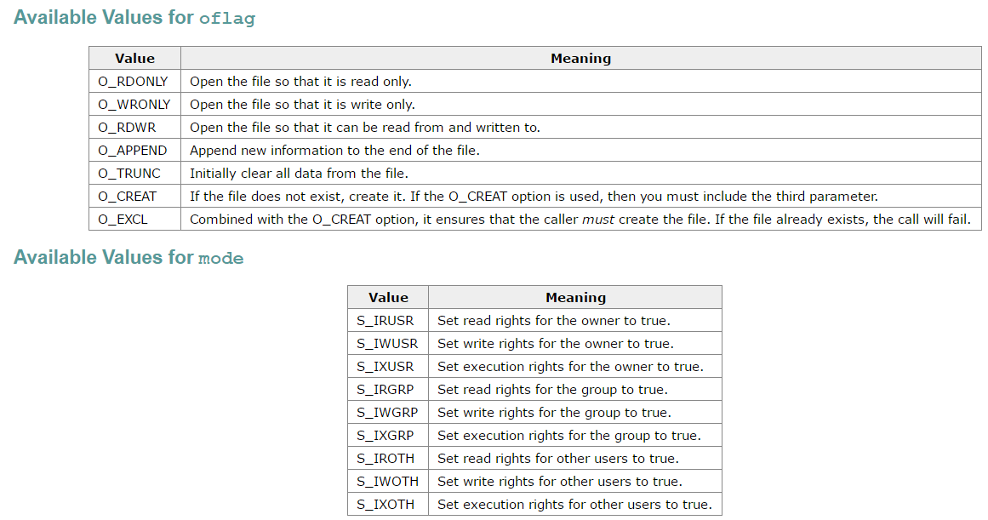
oflag and mode
Source: http://codewiki.wikidot.com/c:system-calls:open

Slide 5
open function Example
Create output file, if it doesn't exist. Empty the file, if it exists.
If ((outputFile = open(“test.txt”,
O_WRONLY|O_CREAT|O_TRUNC,
0644))==-1) {
fprintf(stderr, “Cannot open test.txt.\n");
exit(-1);
}

Slide 6
close function
#include <unistd.h>
int close(int file_descriptor);
Returns: 0 if OK, –1 on error

Slide 7
lseek function
Reposition the offset of the file descriptor
#include <sys/types.h>
#include <unistd.h>
off_t lseek(int file_descriptor, off_t offset, int whence);
Returns: new file offset if OK, -1 on error

Slide 8
lseek function
The interpretation of the offset depends on the value of the whence argument:
SEEK_SET
the file's offset is set to offset bytes from the beginning of the file.
SEEK_CUR
the file's offset is set to its current value plus the offset. The offset can be positive or negative.
SEEK_END
the file's offset is set to the size of the file plus the offset. The offset can be positive or negative.

Slide 9
lseek function Example
Move to byte #15
newPosition = lseek(file_descriptor, 15, SEEK_SET);
Move forward 4 bytes
newPosition = lseek(file_descriptor, 4, SEEK_CUR);
Move to 6 bytes from the end
newPosition = lseek(file_descriptor, -6, SEEK_END);

Slide 10
read function
#include <unistd.h>
ssize_t read(int file_descriptor, void *buff, size_t nbytes);
Returns: number of bytes read, 0 if end of file, –1 on error

Slide 11
write function
#include <unistd.h>
ssize_t write(int file_descriptor, const void *buff, size_t nbytes);
Returns: number of bytes written if OK, -1 on error

